Slide 1
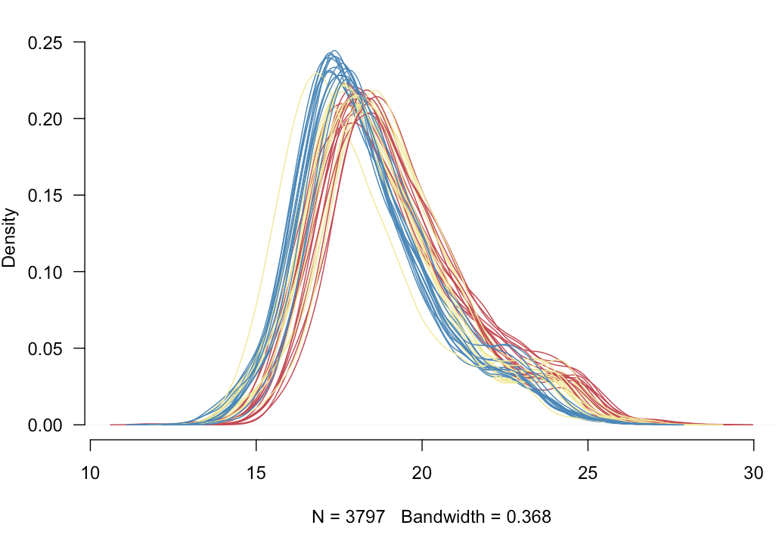
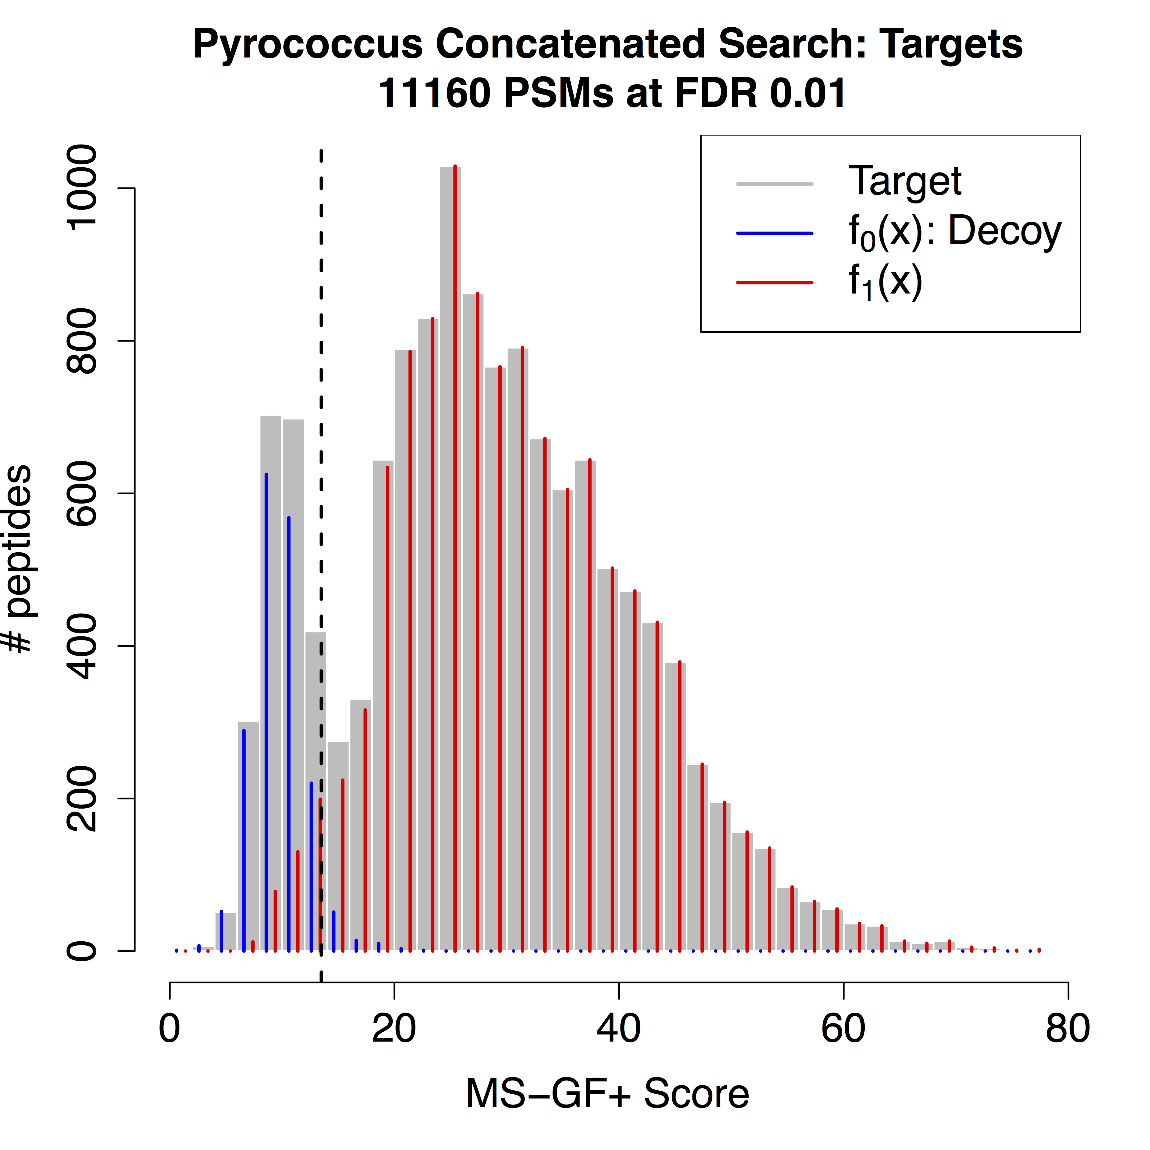
Short Course on Proteomics Data Analysis: Identification and Differential Analysis

